Slide 1
ANALISIS WEBSITE BERITA ONLINE DI SULAWESI SELATAN MENGGUNAKAN METODE USABILITY TESTING DAN HEURISTIC EVALUATION
Muh. Dippo Arbianto | 181147
Richard Agustiawan | 181118

Slide 2
Tujuan penelitian
Untuk mengetahui website terbaik diantara keenam website yang paling populer di Sulawesi Selatan.

Slide 3
01 rancangan aplikasi
02 Pengumpulan data
03 analisis data
04 hasil penelitian

Slide 4
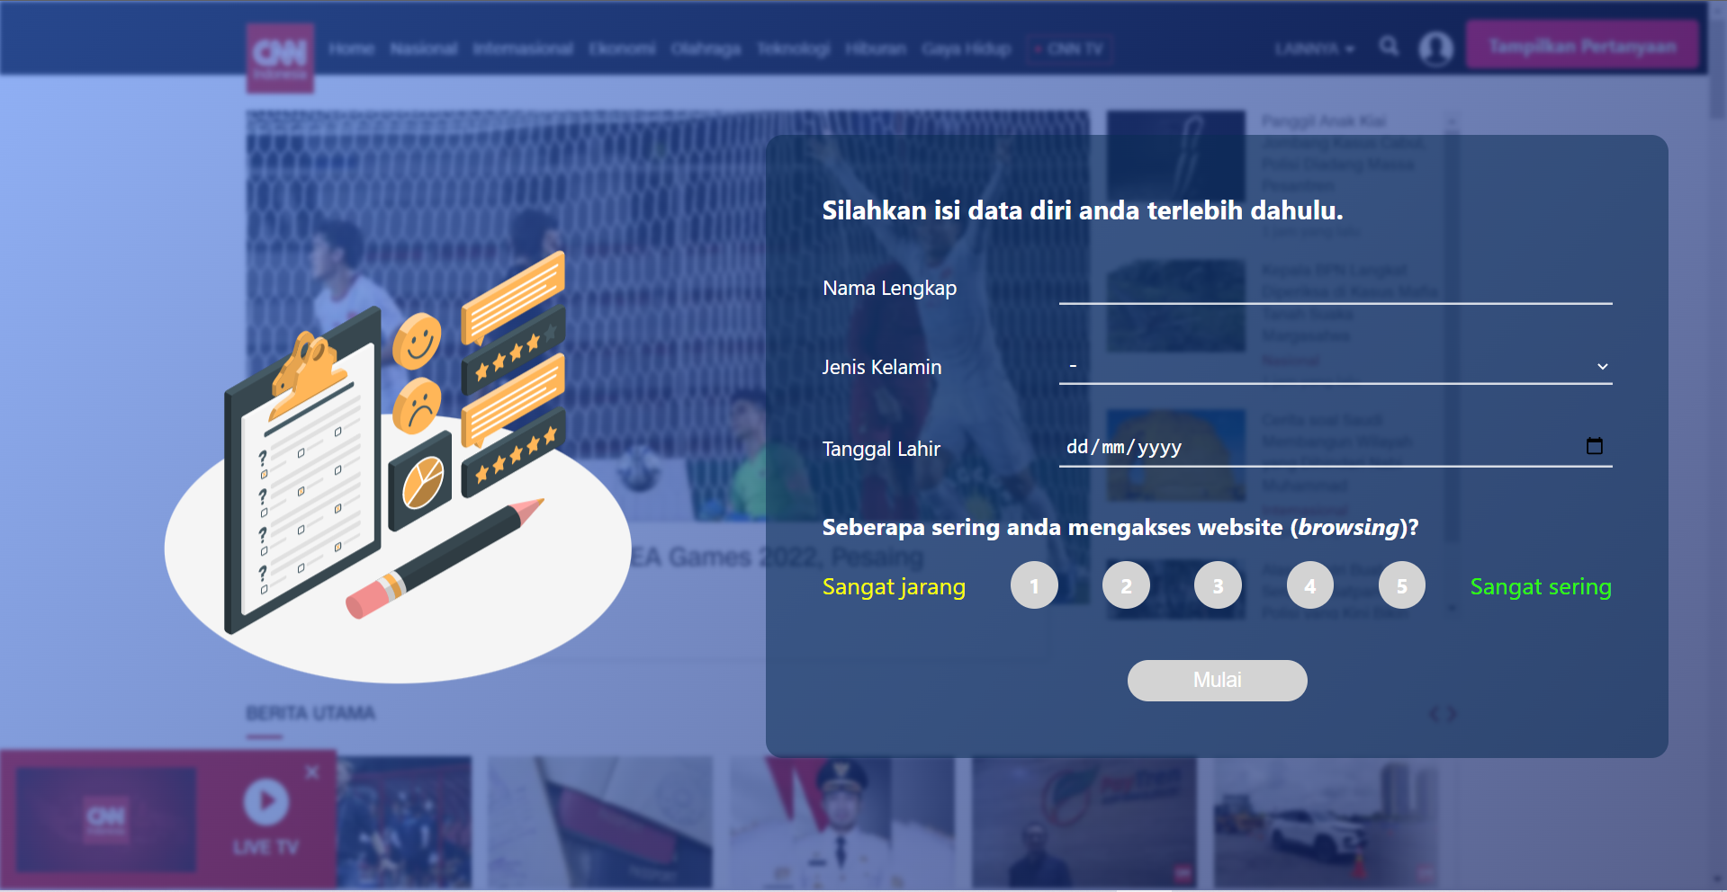
01. Demo aplikasi

Slide 5
02. Analisis data

Slide 6
03. hasil penelitian

Slide 7
03. hasil penelitian

Slide 8
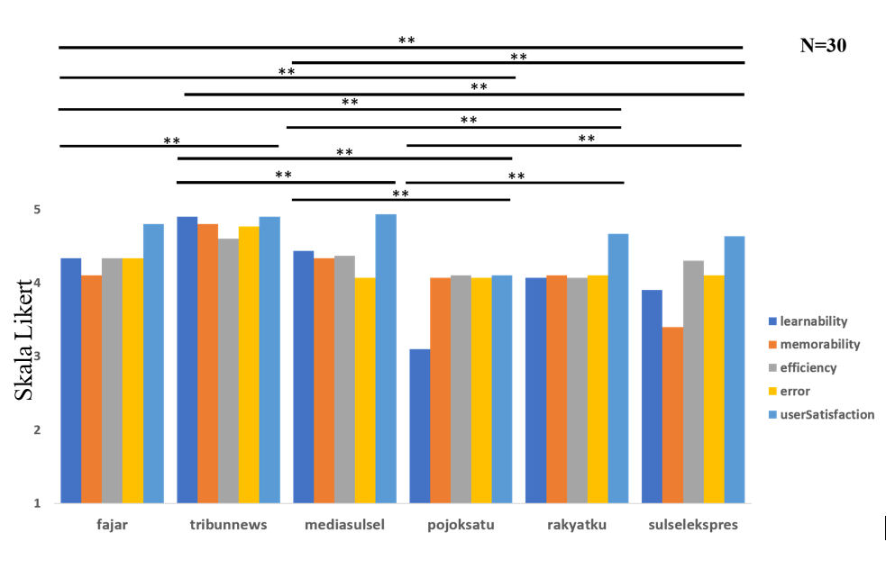
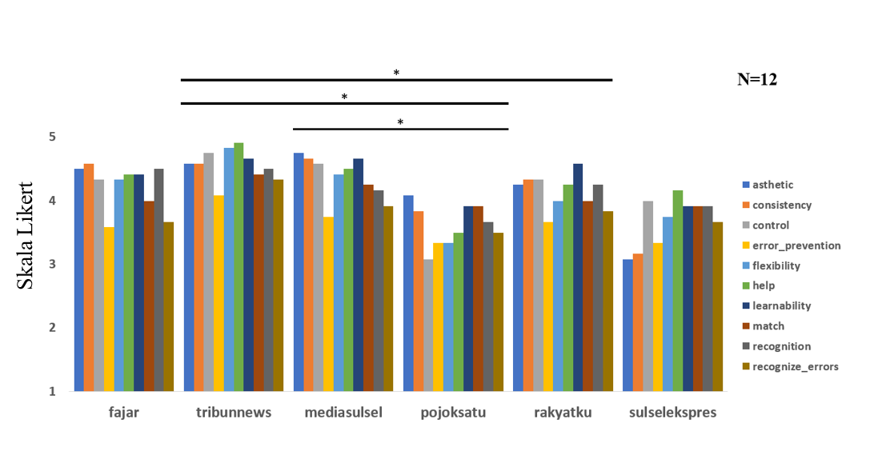
Grafik perbandingan antar website
Usability Testing
Heuristic Evaluation

Slide 9
Tabel perbandingan website
No | Website 1 | Perbandingan | Website 2 | z
1 | fajar | < | tribun | -6,677b
2 | fajar | = | mediasulsel | -,921b
3 | fajar | > | pojoksatu | -6,200c
4 | fajar | < | rakyatku | -3,516c
5 | fajar | > | sulselekspres | -5,096c
6 | tribun | > | mediasulsel | -5,508c
7 | tribun | > | pojoksatu | -8,957c
8 | tribun | > | rakyatku | -8,406c
9 | tribun | > | sulselekspres | -8,103c
10 | mediasulsel | > | pojoksatu | -6,360c
11 | mediasulsel | > | rakyatku | -3,901c
12 | mediasulsel | > | sulselekspres | -5,121c
13 | pojoksatu | < | rakyatku | -4,287b
14 | pojoksatu | = | sulselekspres | -2,310b
15 | rakyatku | = | sulselekspres | -2,150c
No. | Website 1 | Perbandingan | Website 2 | z
1 | fajar | = | tribun | -2,821c
2 | fajar | = | mediasulsel | -2,814c
3 | fajar | = | pojoksatu | -2,807c
4 | fajar | = | rakyatku | -2,807c
5 | fajar | = | sulselekspres | -2,807c
6 | tribun | = | mediasulsel | -2,805c
7 | tribun | > | pojoksatu | -2,803c
8 | tribun | > | rakyatku | -2,803b
9 | tribun | = | sulselekspres | -2,670c
10 | mediasulsel | > | pojoksatu | -2,661c
11 | mediasulsel | = | rakyatku | -2,536b
12 | mediasulsel | = | sulselekspres | -2,203c
13 | pojoksatu | = | rakyatku | -1,809b
14 | pojoksatu | = | sulselekspres | -1,691c
15 | rakyatku | = | sulselekspres | -,507b
Usability Testing
Heuristic Evaluation

Slide 10
Tabel aspek paling berpengaruh
 | fajar | tribun | media | pojok | rakyat | sulsel | Total | Rank
fajar | 0 | -1 | 0 | 1 | -1 | 1 | 0 | 3
tribun | 1 | 0 | 1 | 1 | 1 | 1 | 5 | 1
media | 0 | -1 | 0 | 1 | 1 | 1 | 2 | 2
pojok | -1 | -1 | -1 | 0 | -1 | 0 | -4 | 6
rakyat | 1 | -1 | -1 | 1 | 0 | 0 | 0 | 3
sulsel | -1 | -1 | -1 | 0 | 0 | 0 | -3 | 5
 | fajar | tribun | media | pojok | rakyat | sulsel | Total | Rank
fajar | 0 | 0 | 0 | 0 | 0 | 0 | 0 | 3
tribun | 0 | 0 | 0 | 1 | 1 | 0 | 2 | 1
media | 0 | 0 | 0 | 1 | 0 | 0 | 1 | 2
pojok | 0 | -1 | -1 | 0 | 0 | 0 | -2 | 6
rakyat | 0 | -1 | 0 | 0 | 0 | 0 | -1 | 5
sulsel | 0 | 0 | 0 | 0 | 0 | 0 | 0 | 3
Usability Testing
Heuristic Evaluation

Slide 11
Aspek paling berpengaruh?

Slide 12
kesimpulan

Slide 13
Sesi tanya jawab

